Slide 1


Slide 2

INTRODUCE a new option in GNOD web page search engine by song and not by band

Slide 3
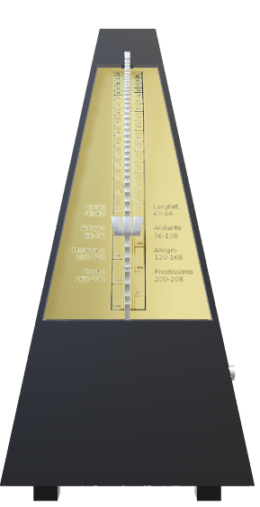
How can we do that?
Dataset: currently popular songs (100 hot songs billboard) and all time favourites (around 2000 songs)
Clustered by their musical features
We used a KMean method that we used to build models with different number of clusters.
Best performing model (lowest silhouette), 16 clusters

Slide 4


How does it work?
New option in the web page offering the user the alternative to input a song
The model assigns the song to one of the clusters and then recommends a song to the user from the same cluster, with a preference for a song that is currently popular
Recommender still in its design phase

Slide 5
NEXT STEPS
1
Use other methods to cluster the songs, test if they work better
2
Refine the database with new songs
3
Test the recommender in the webpage and see how it behaves

Slide 6


Thank you

